Slide 1
Nervous System Numeric Response Practice

Slide 2
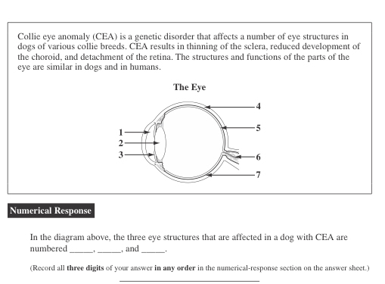
#1
4 5 7

Slide 3
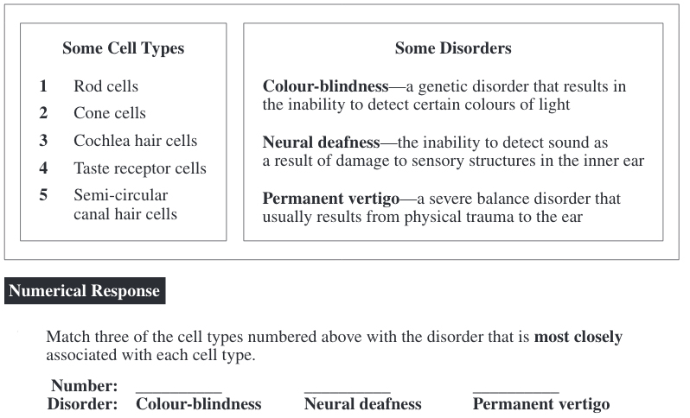
#2
2 3 5

Slide 4
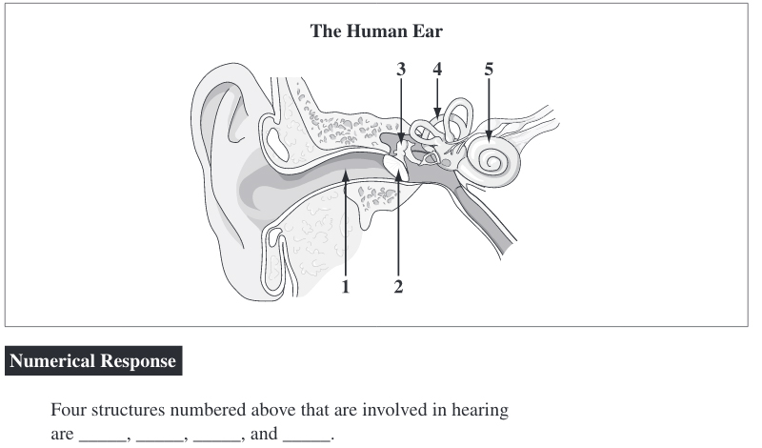
#3
1 2 3 5

Slide 5
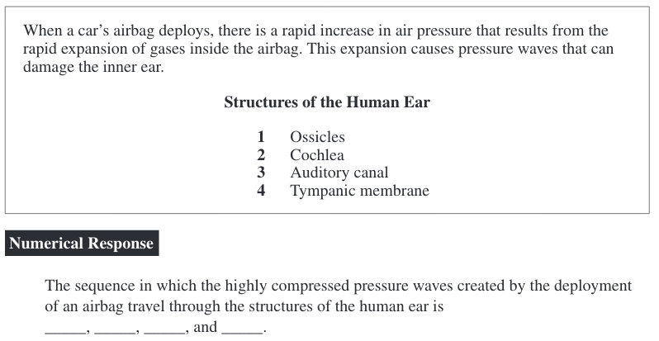
#4
3 4 1 2

Slide 6
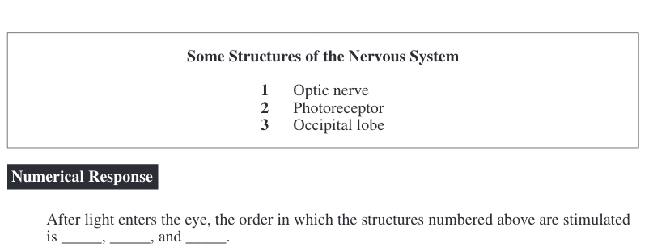
#5
2 1 3

Slide 7
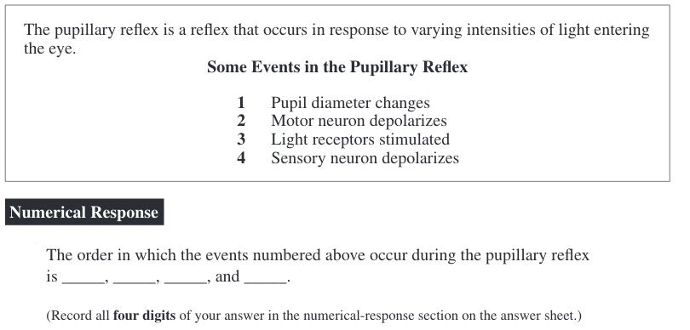
#6
3 4 2 1

Slide 8
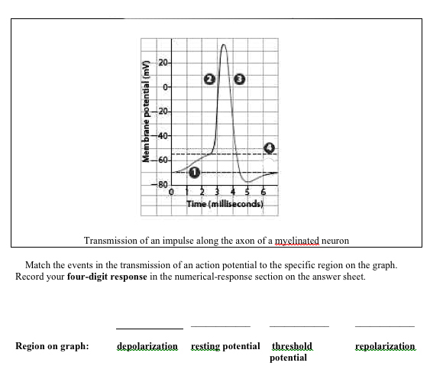
#7
2 1 4 3

Slide 9
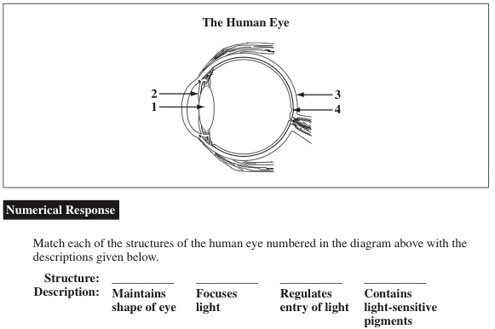
#8
3 1 2 4

